Slide 1
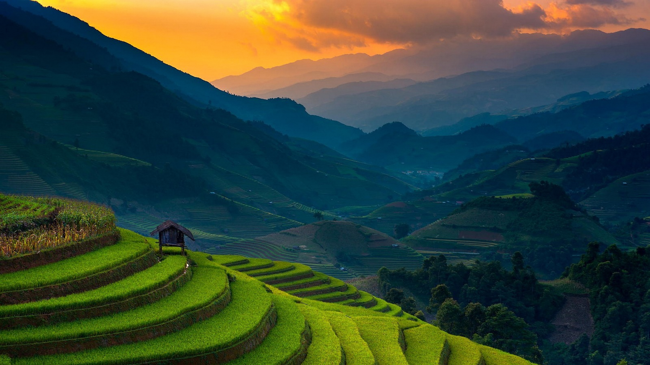
Your Local Home
HOLIDAY HOME NT
Mohammad Jobaidul Hoque
Synthia Islam

Slide 2
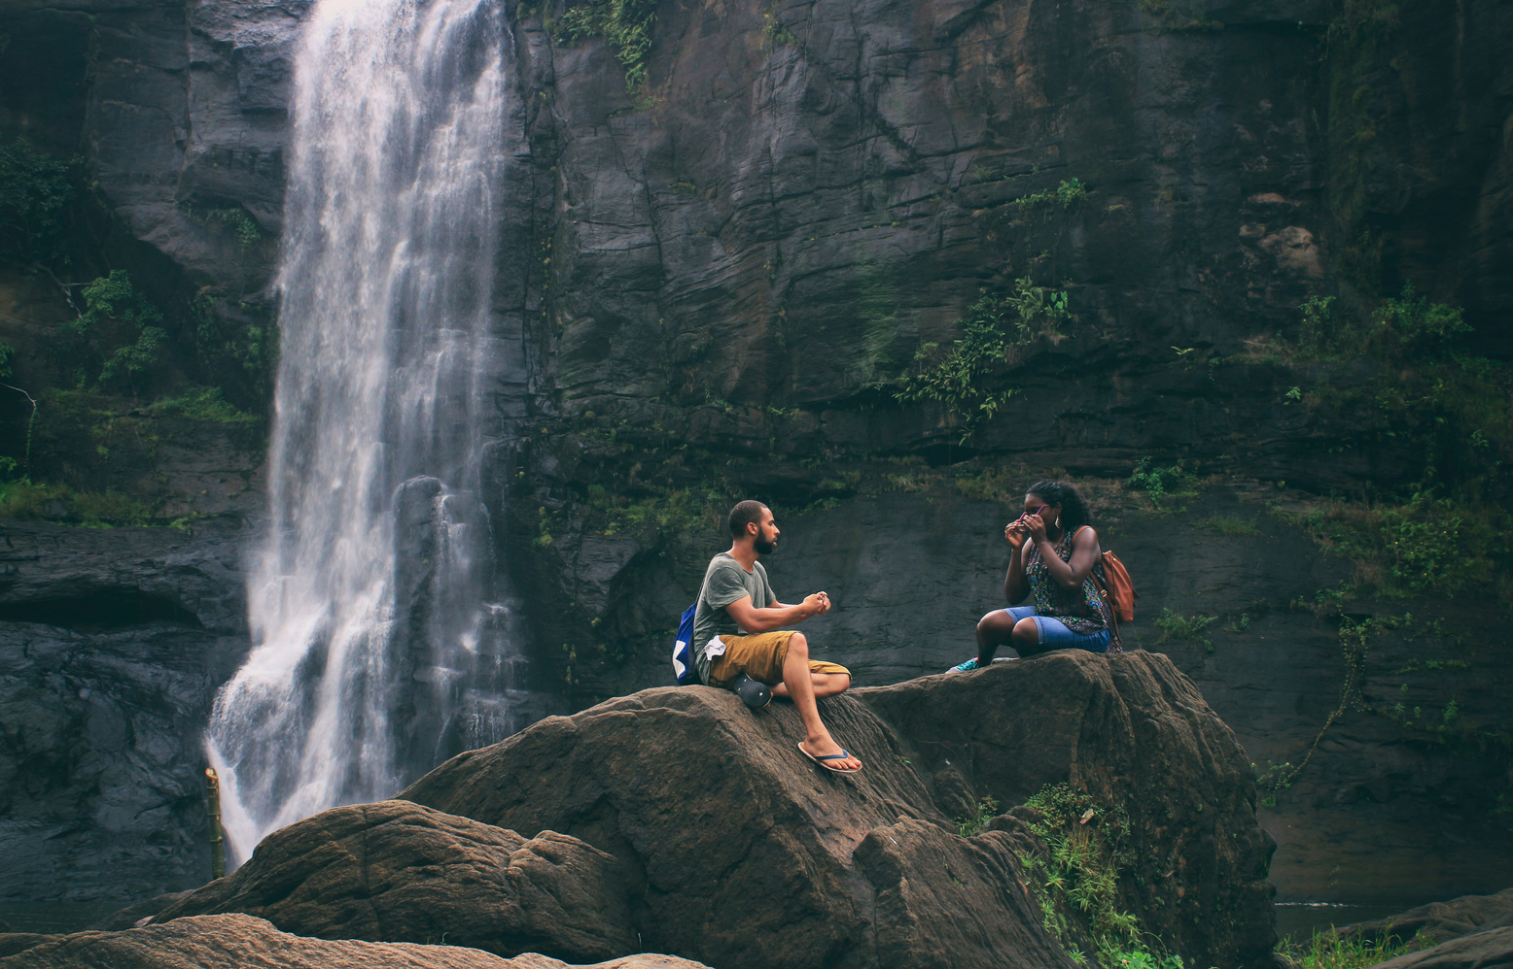
PROBLEMS
Limited Services Provider in Remote Areas
Insufficient Accommodation Options
Lack of Engaging Tourism Activities with Indigenous Communities
Declining Visitor Numbers

Slide 3
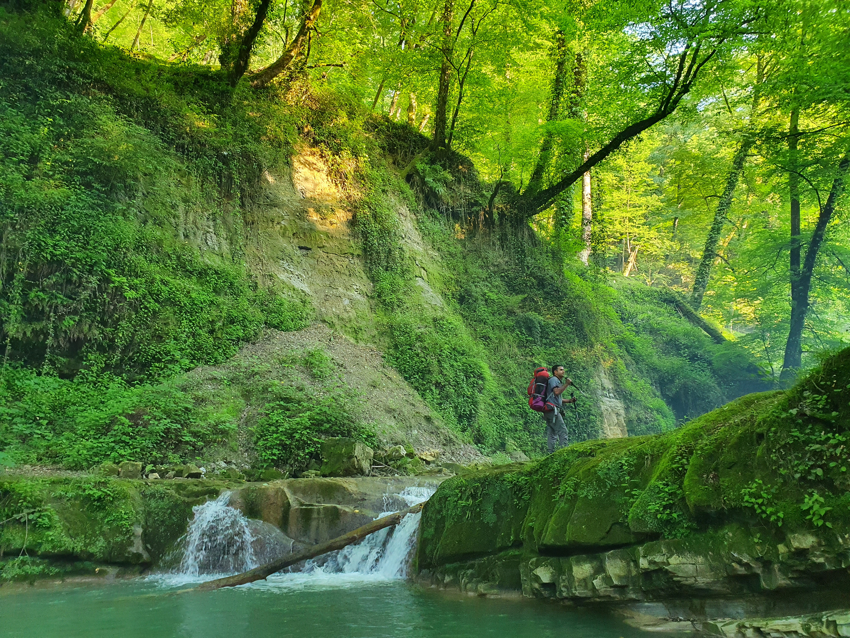
PROBLEMS 01
Limited Service Providers in Remote Areas
“A tourist planning to visit a remote part of the Northern Territory, such as a secluded Aboriginal community, might find it challenging to access basic services like guided tours, transportation, or cultural experiences due to the lack of service providers”

Slide 4
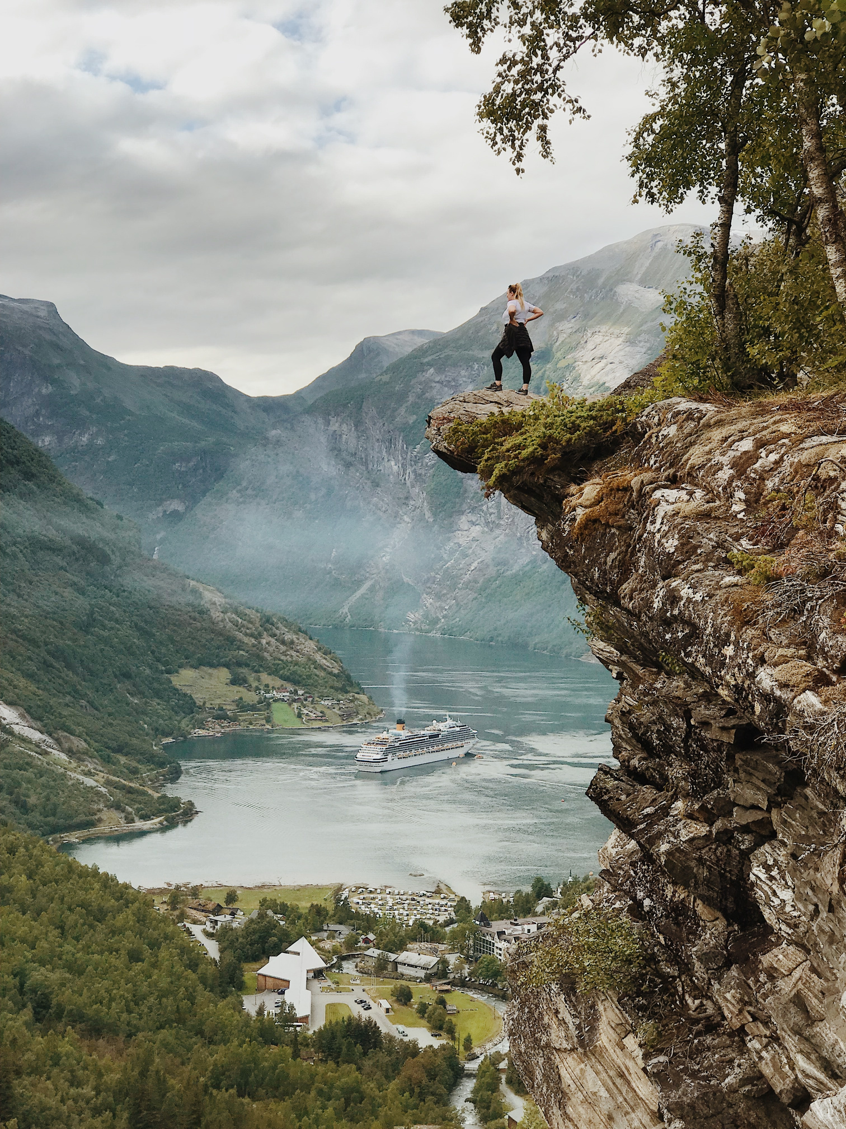
PROBLEM 02
Insufficient Accommodation Options
“A group of tourists travelling to explore NT’s remote wilderness may struggle to find suitable places to stay, especially in areas not near major towns or cities. This could also deter tourists from visiting remote regions, where accommodations are sparse, thereby reducing the potential economic benefits”

Slide 5
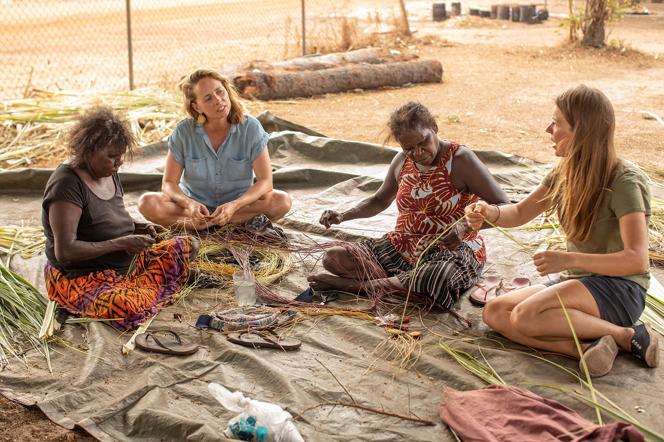
PROBLEM 03
Lack of Engaging Tourism Activities with Indigenous Communities
“Tourists in NT often miss authentic cultural experiences due to the lack of engaging activities with Indigenous communities. Visitors may feel disconnected from the region's rich cultural heritage without immersive opportunities like staying with local families or participating in traditional practices.”

Slide 6




EFFECTS OF PROBLEMS
Declining Visitor Numbers
1,701,000 Mar’23 1,646,000 Mar ‘24
-3.2%

Slide 7
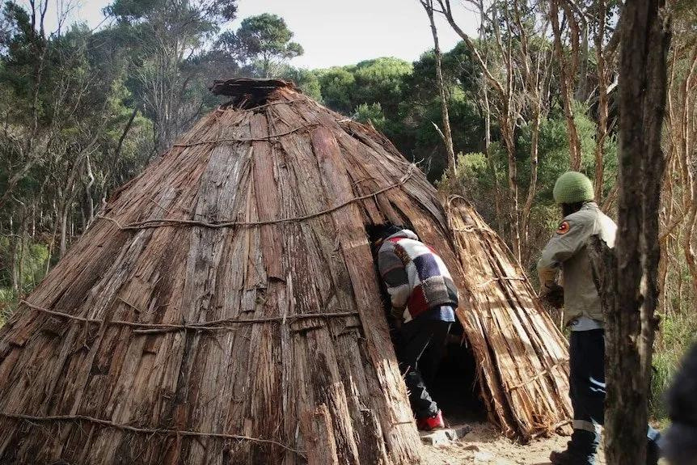
SOLUTIONS
Holiday Home NT
Holiday Home NT offers tourists the opportunity to stay with local families in their homes, allowing them to fully immerse themselves in the traditional Aboriginal lifestyle.
Tourists can live like locals, sharing meals, engaging in daily activities, and experiencing adventures such as fishing, hunting, and other culturally significant practices.

Slide 8
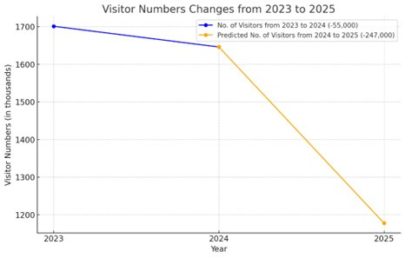
SOLUTIONS
Automated Visitor Prediction Model
- Using Machine Learning
We also developed a Machine Learning Model to predict future visitor trends, including the total number of visitors and the specific locations they are likely to visit, helping the government and businesses identify priority areas for promoting holiday homes, especially in remote regions likely to become future tourist hotspots.

Slide 9
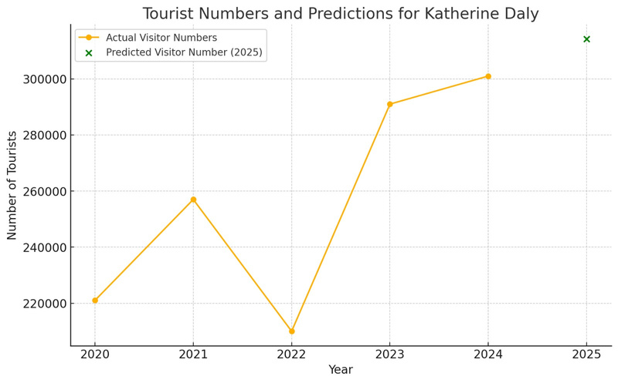
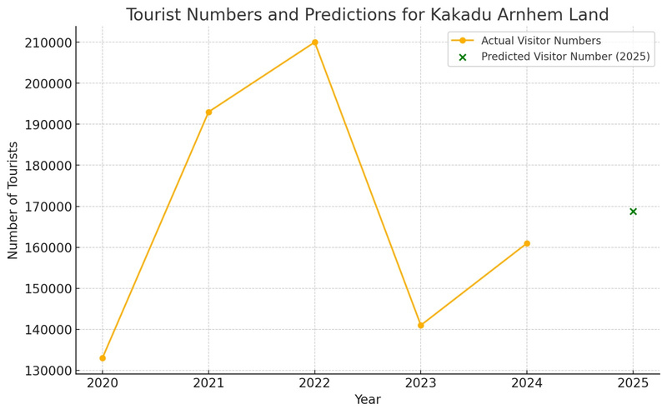
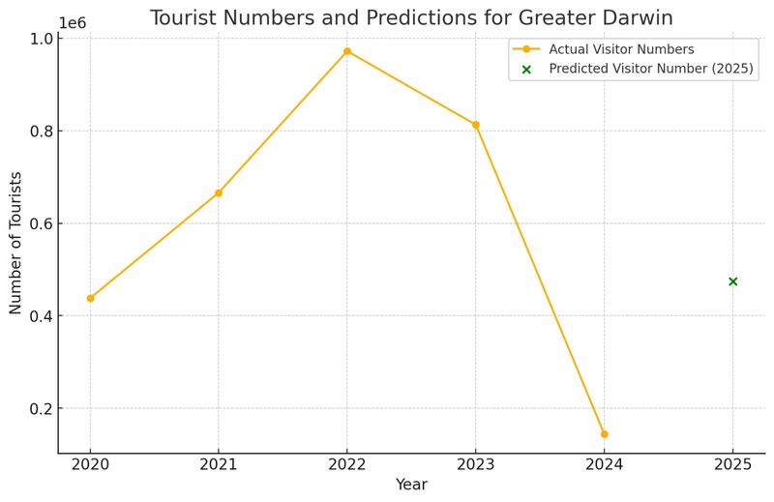
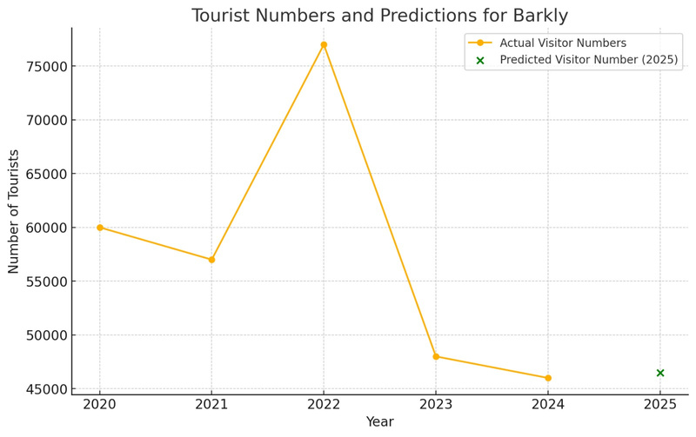
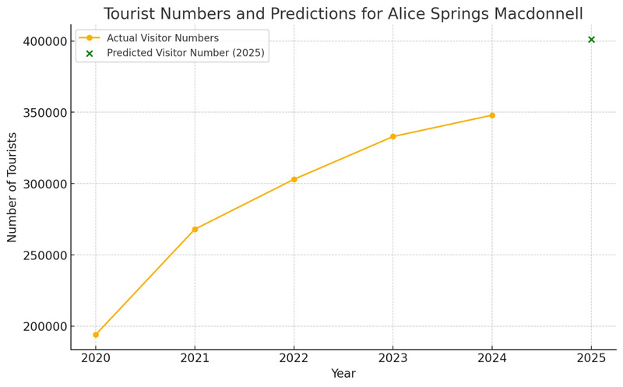
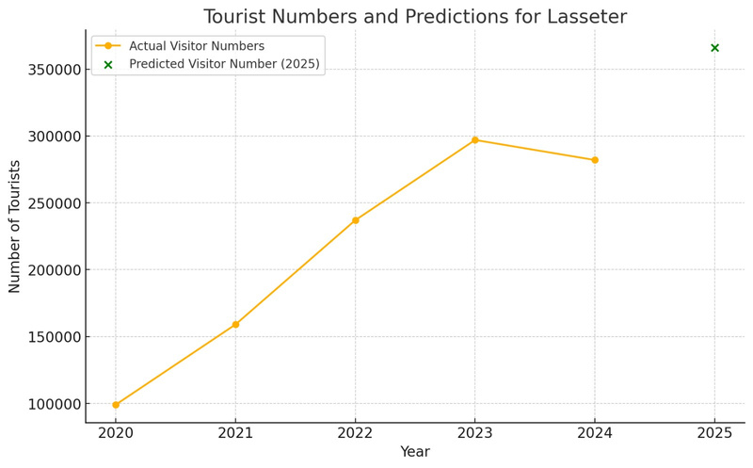
Automated Visitor Prediction Model
Trend number of Visitors & What places they are likely to visit

Slide 10

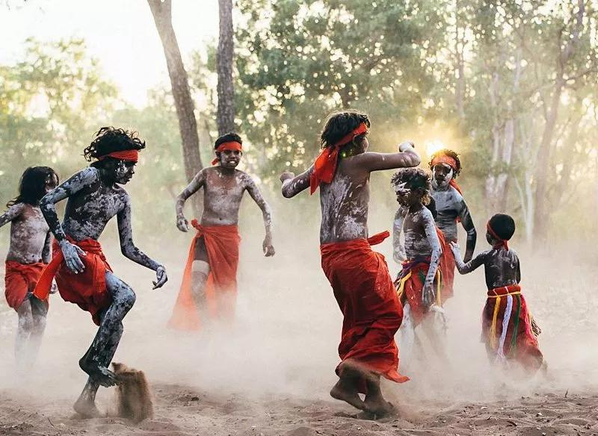




Outcomes
Empowerment of Indigenous Communities
Tourism Growth and Economic Impact
Unique and Authentic Tourism
Sustainable Tourism Practices

Slide 11






FEASIBILITY
Cost-Effective, Scalable Machine Learning Model
Resource Efficiency
Ready Local Population Base
Minimal Upfront Investment
Alignment with Global Sustainability Goals

Slide 12
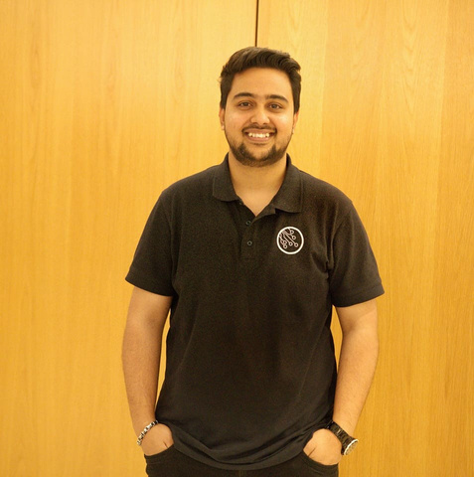
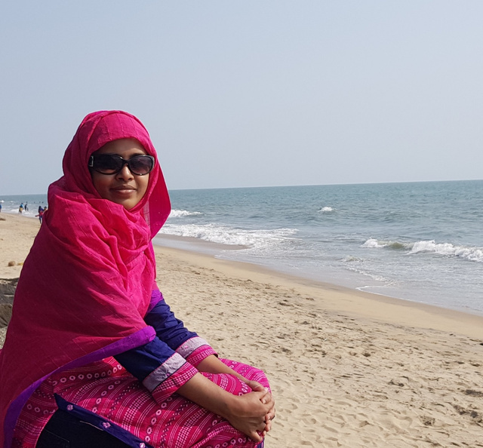
TEAM MEMBERS
Mohammad Jobaidul Hoque
Synthia Islam
s369199@students.cdu.edu.au
s375728@students.cdu.edu.au

